Slide 1
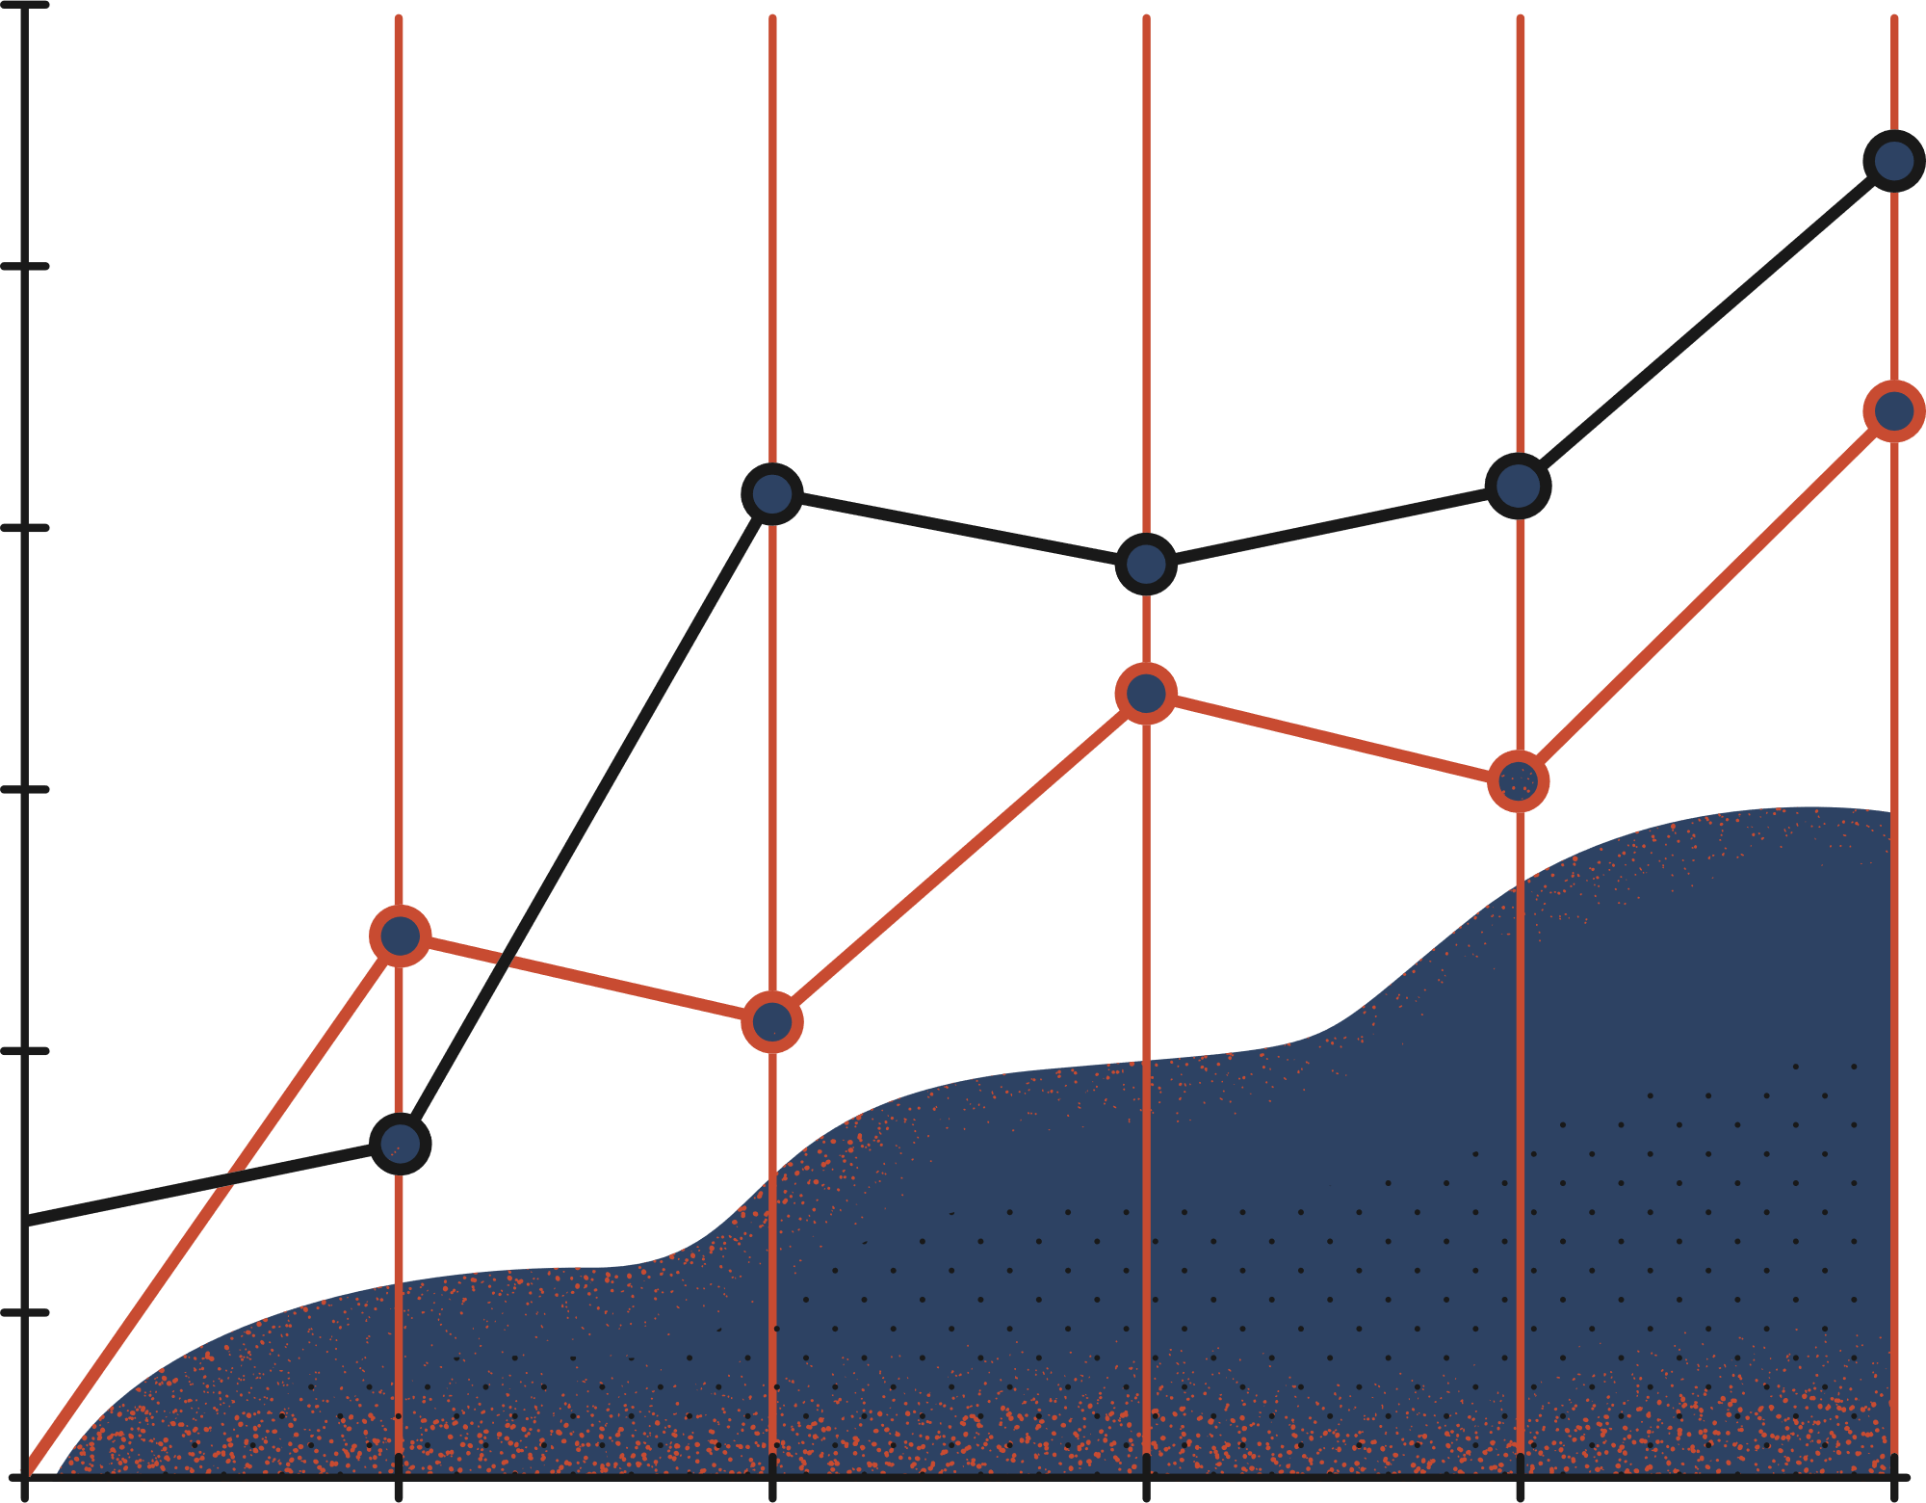

Thursday, 29/09/2022
VIT Bhopal
PROJECT
TRANSLATOR
GROUP NO.
ADVISOR
220
Dr. Jay Prakash Maurya

Slide 2

The Contributors
Jehan Patel 21BCE10551
Neel Jain 21BCE10542
B. Vijay 21BCE10609
Sarvesh Aditya J. 21BCE10570
Abhinav 21BCE10629

Slide 3
Table of Contents
I
Introduction
II
Existing work with limitations
III
Proposed work with methodology
IV
Novelty of the project
V
Real time usage
VI
Hardware and Software Requirements

Slide 4
Table of Contents
VII
Overall system architecture design
VIII
Literature review
IX
Module Description
X
Module workflow explaination
XI
Inplementation and coding
XII
Demo Video

Slide 5
Table of Contents
XIII
Snapshot
XIV
Testing
XV
Result
XVI
Conclusion

Slide 6

I
Introduction
Translation is the process of conveying a written source language text clearly, completely, accurately into a target language. The translation process involves translation, editing and proofreading.
Translation is an activity, a product, and a process. As an activity, translation is a complex act that requires close reading of a text in the source language, understanding its meaning and creating an equivalent text in the target language.

Slide 7
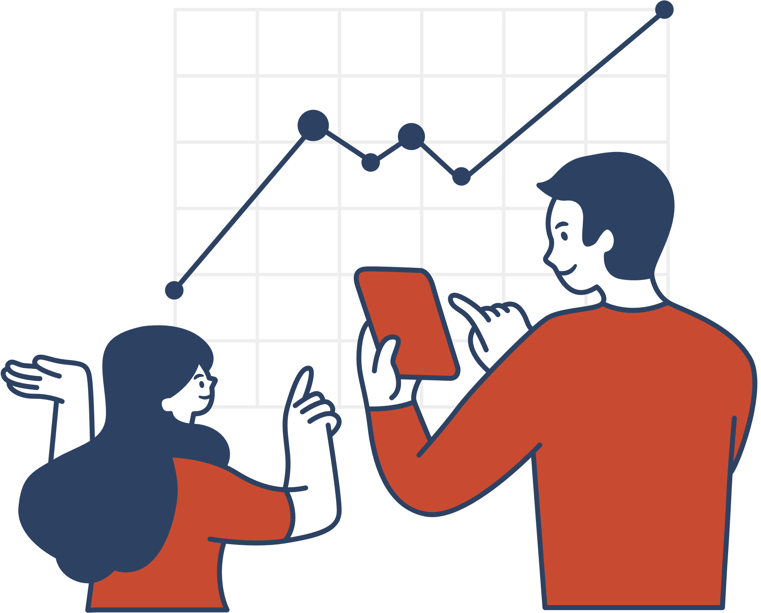
II
Existing work with limitations
The "Limitless" Translator
We have successfully build a translator with a working GUI and we can translate text and provide the output as speech in the language of your choice.
It can also function by converting speech into text and translating it into the language of your choice.
However with the positives, it still has some limitations. The application sometimes find it hard to understand the accents of some places and therefore translation becomes incorrect. Also the loading time is a bit slow sometimes.

Slide 8
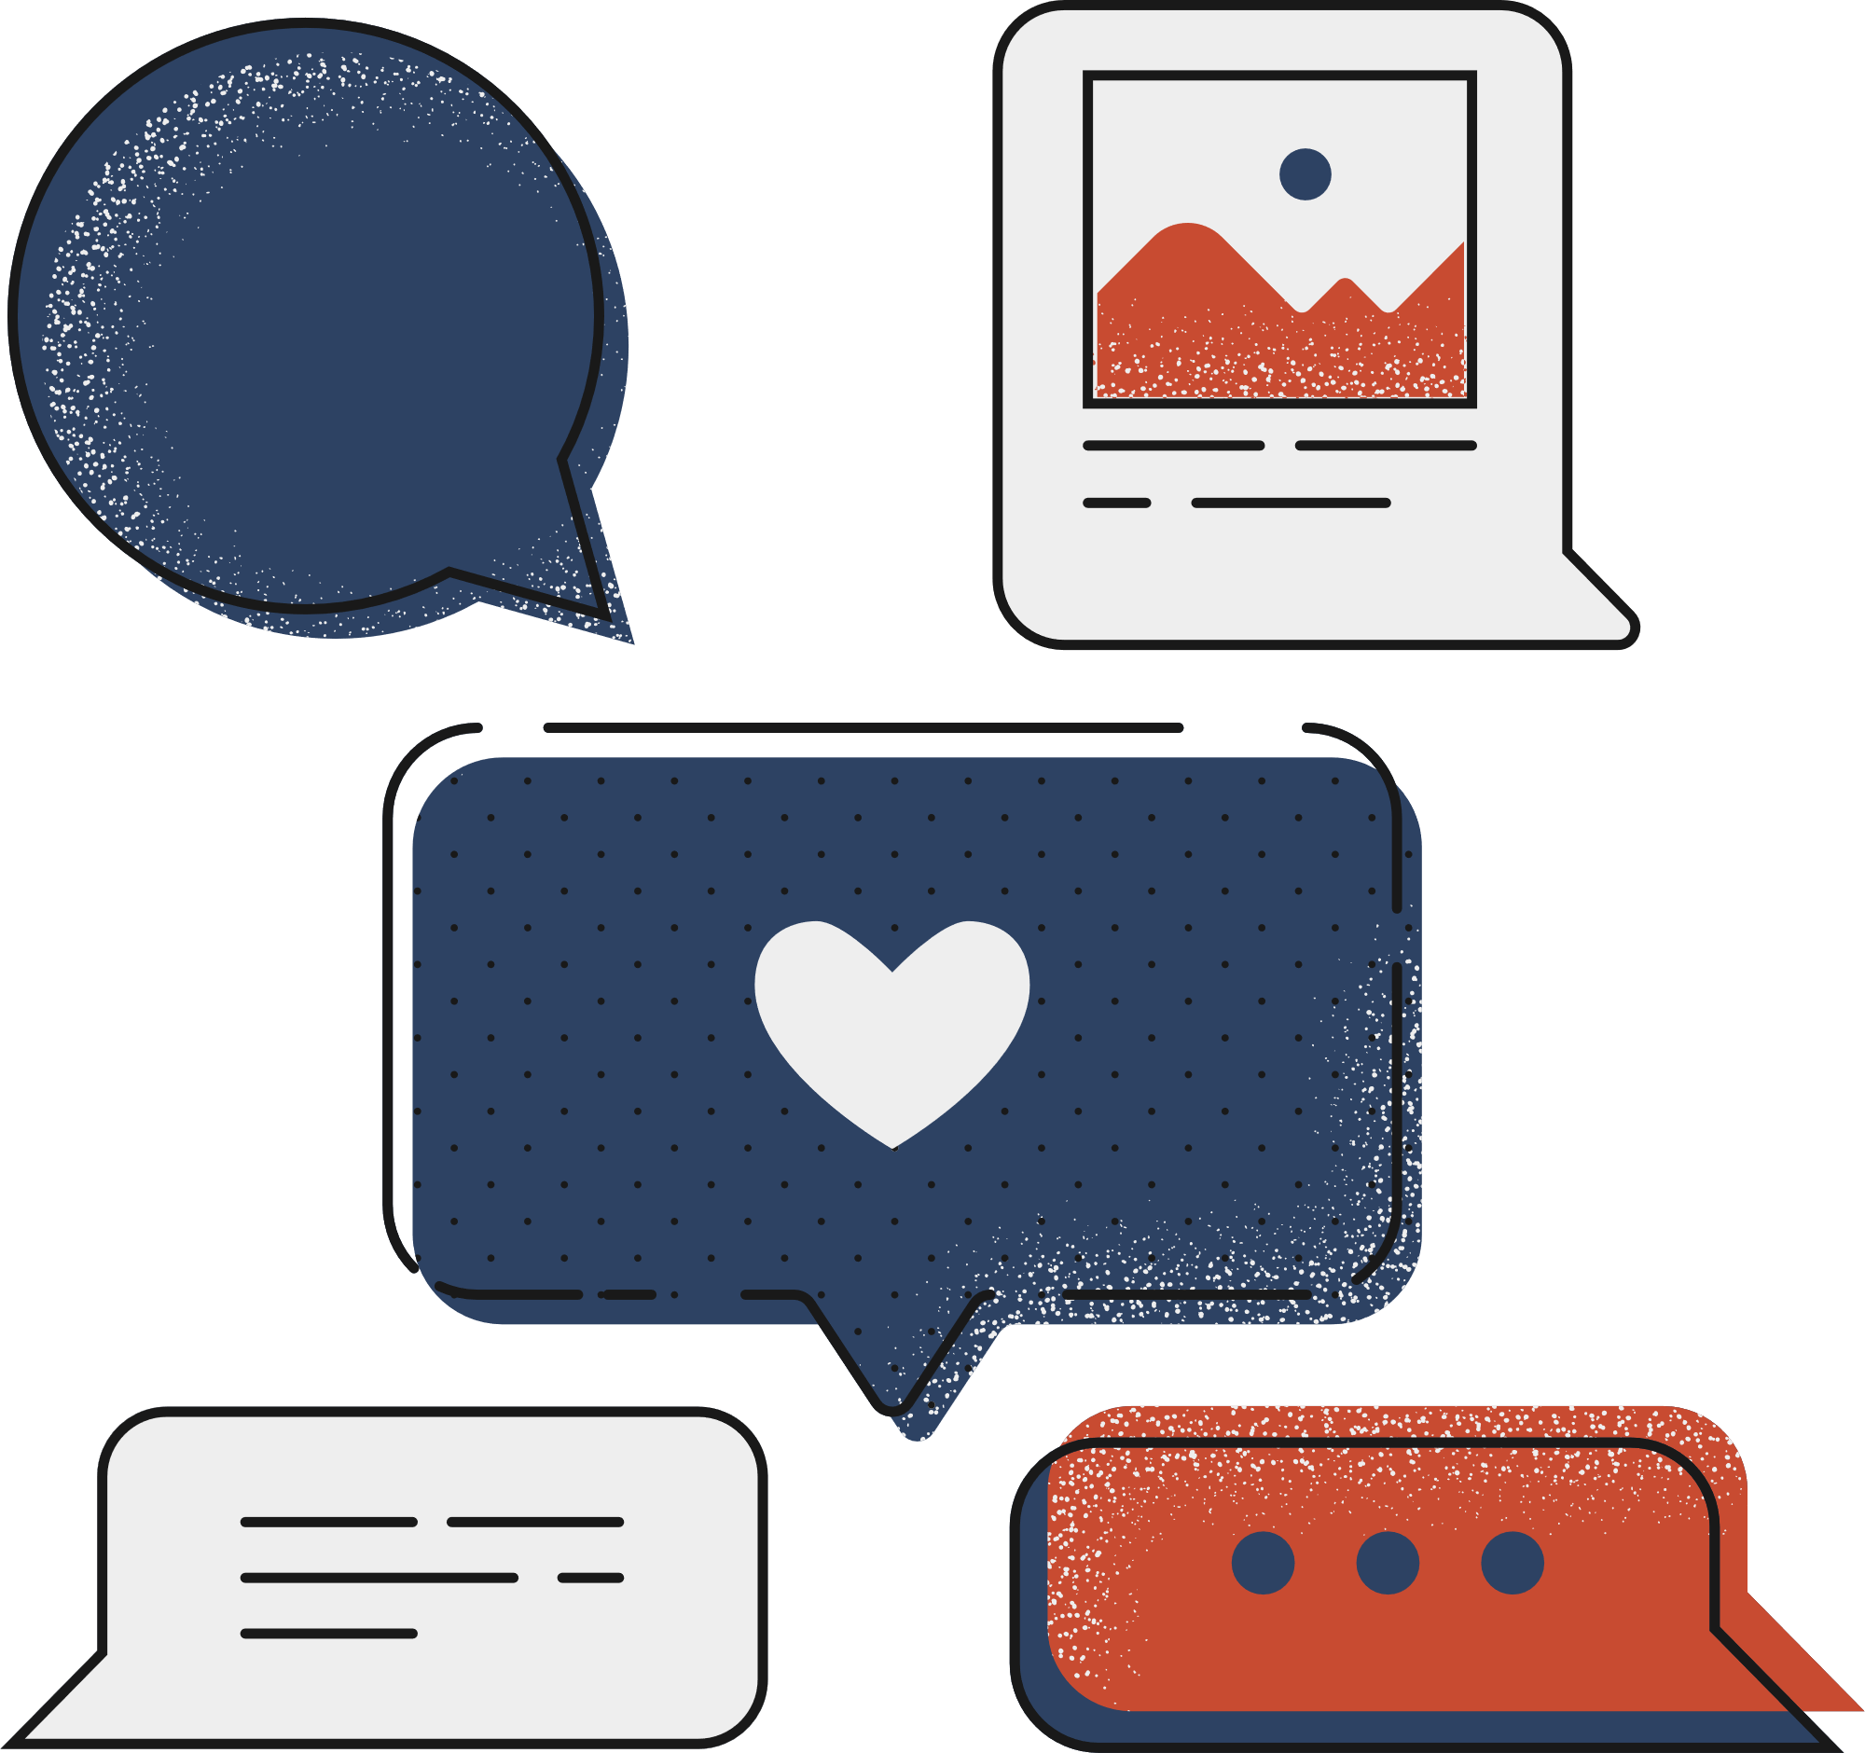
III
Proposed work and methodology
The "Intelligent" Translator
We have proposed a translator which is easily accessible and is more accurate when working with different dialects.
It will work on API namely Microsoft Azure Cognitive Services where the translator will have access to different machine learning models already available in the cloud. The translator will access those models and will translate the text into the desired language through API requests. The result will be sent back to the program and will be displayed as the translated text.

Slide 9

IV
Novelty of the Project
The "Novel" Translator
Our translator is a novel project. Our translator has a ton on features in one single app like text to speech and speech to text translation. We are also looking to integrate more features as we go. Our translator is compact and easy to distribute to the people for them to use.

Slide 10
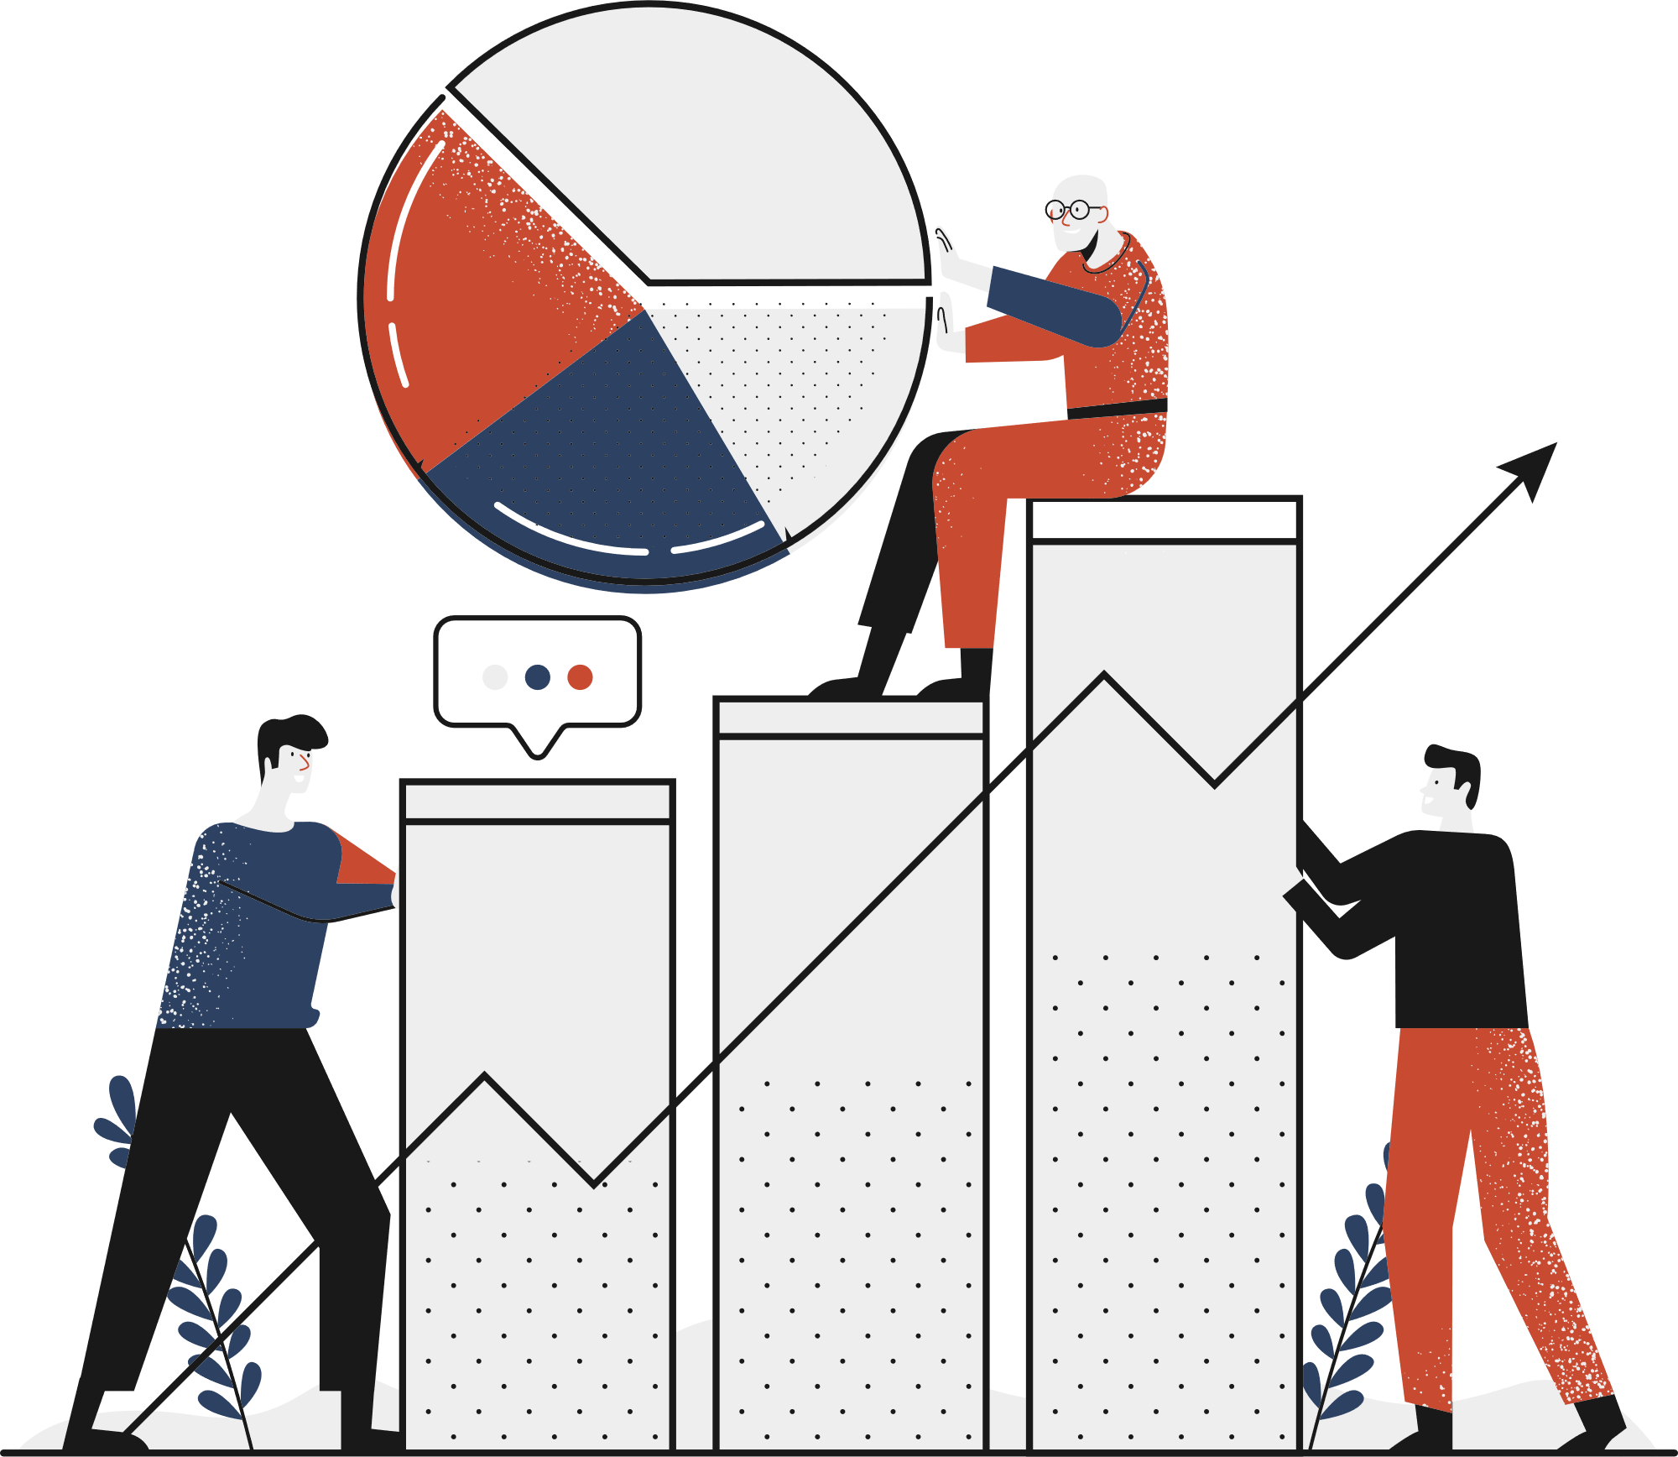
V
Real Time Usage
The "Useful" Translator
If businesses want to access the global audience, they must translate all their technical documents into the languages of their target areas. This is when the technical translation services are required.
In the travel and tourism sector, language translation is required for a variety of things. For example, the translation of travel documents, brochures, and terms and conditions documents is crucial for interacting with people of different regions.

Slide 11

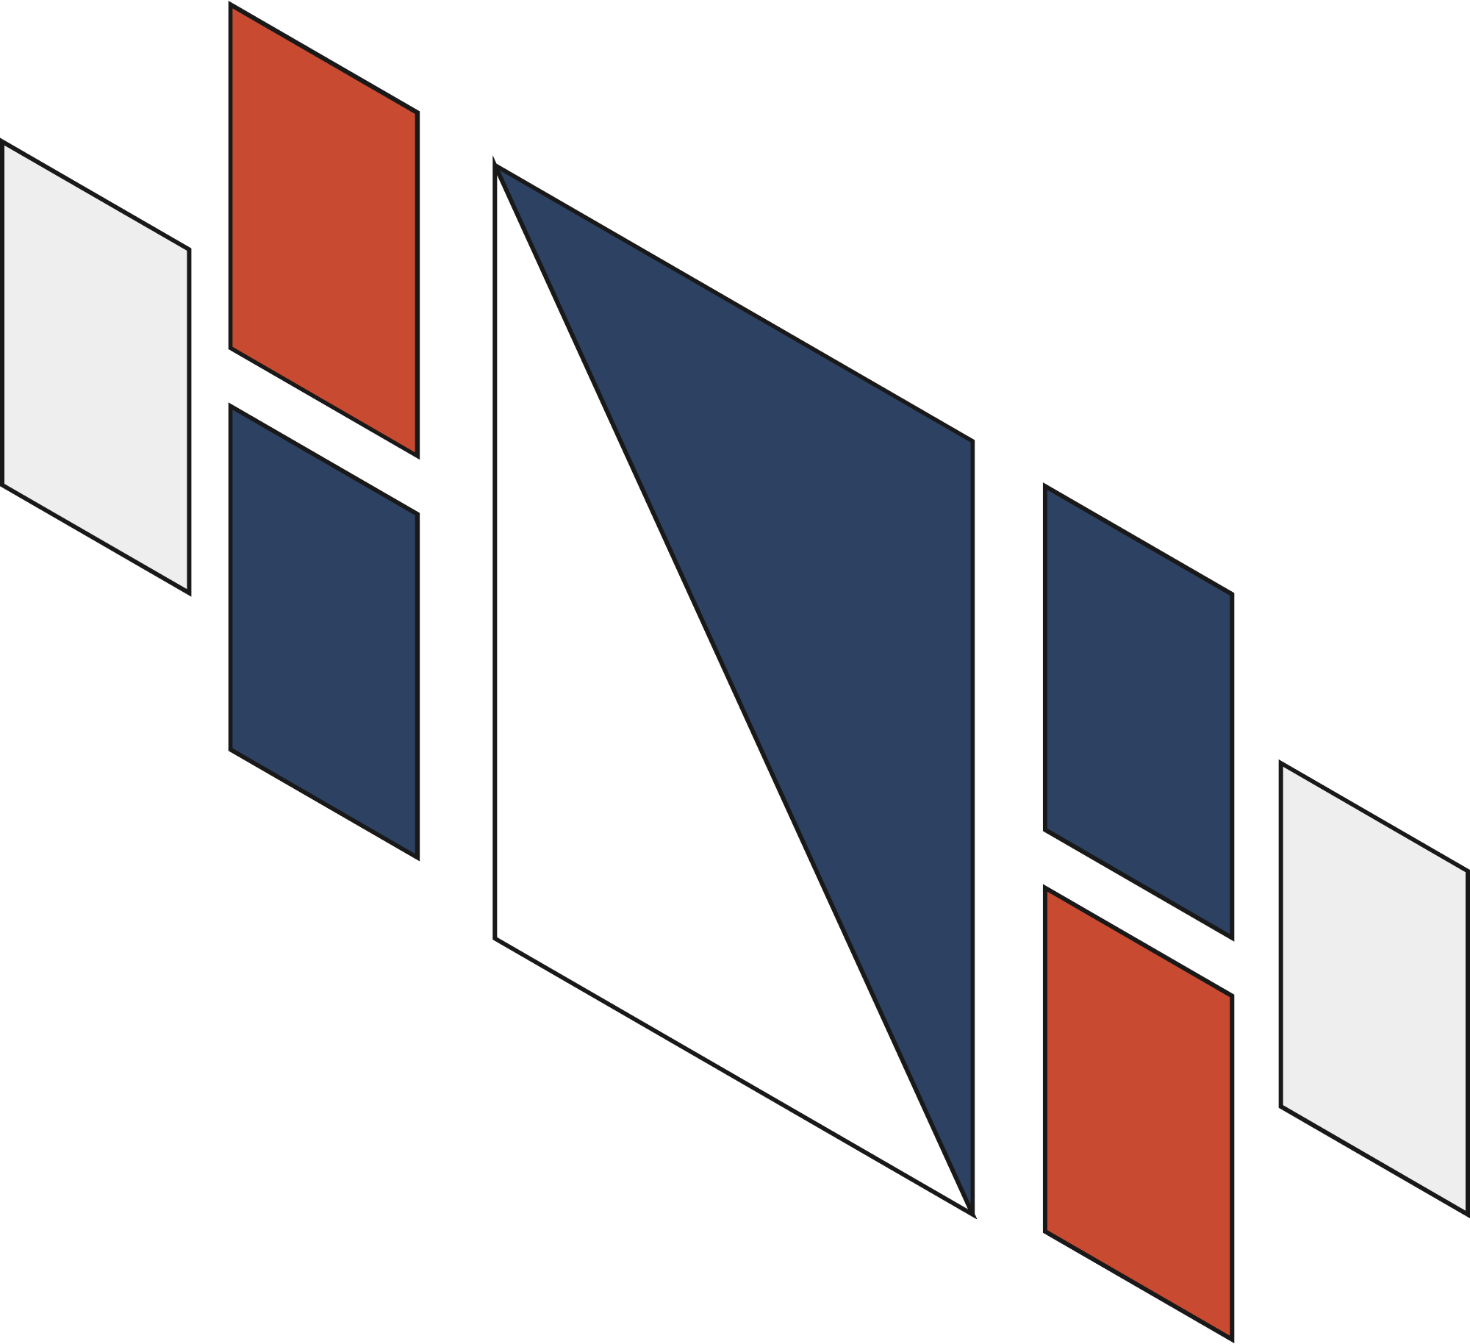
VI
Hardware and Software Requirements
Processor : AMD Ryzen 3 3200G or Intel Core i3 3rd Gen or above
RAM: 2GB RAM or above
Storage: 2GB or above
Software: Visual Studio Code
Language: Python
*Active Internet Connection*

Slide 12
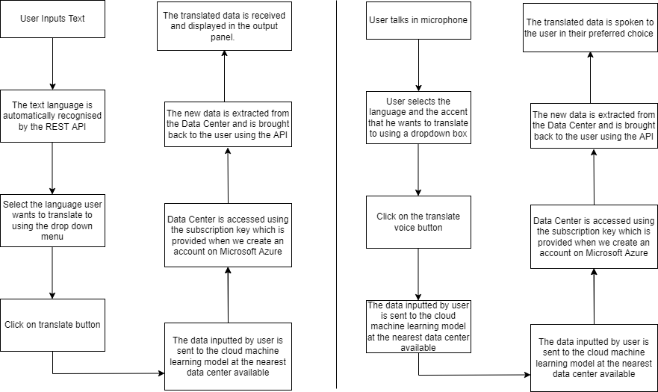
VII
Overall System Architecture and Diagram

Slide 13
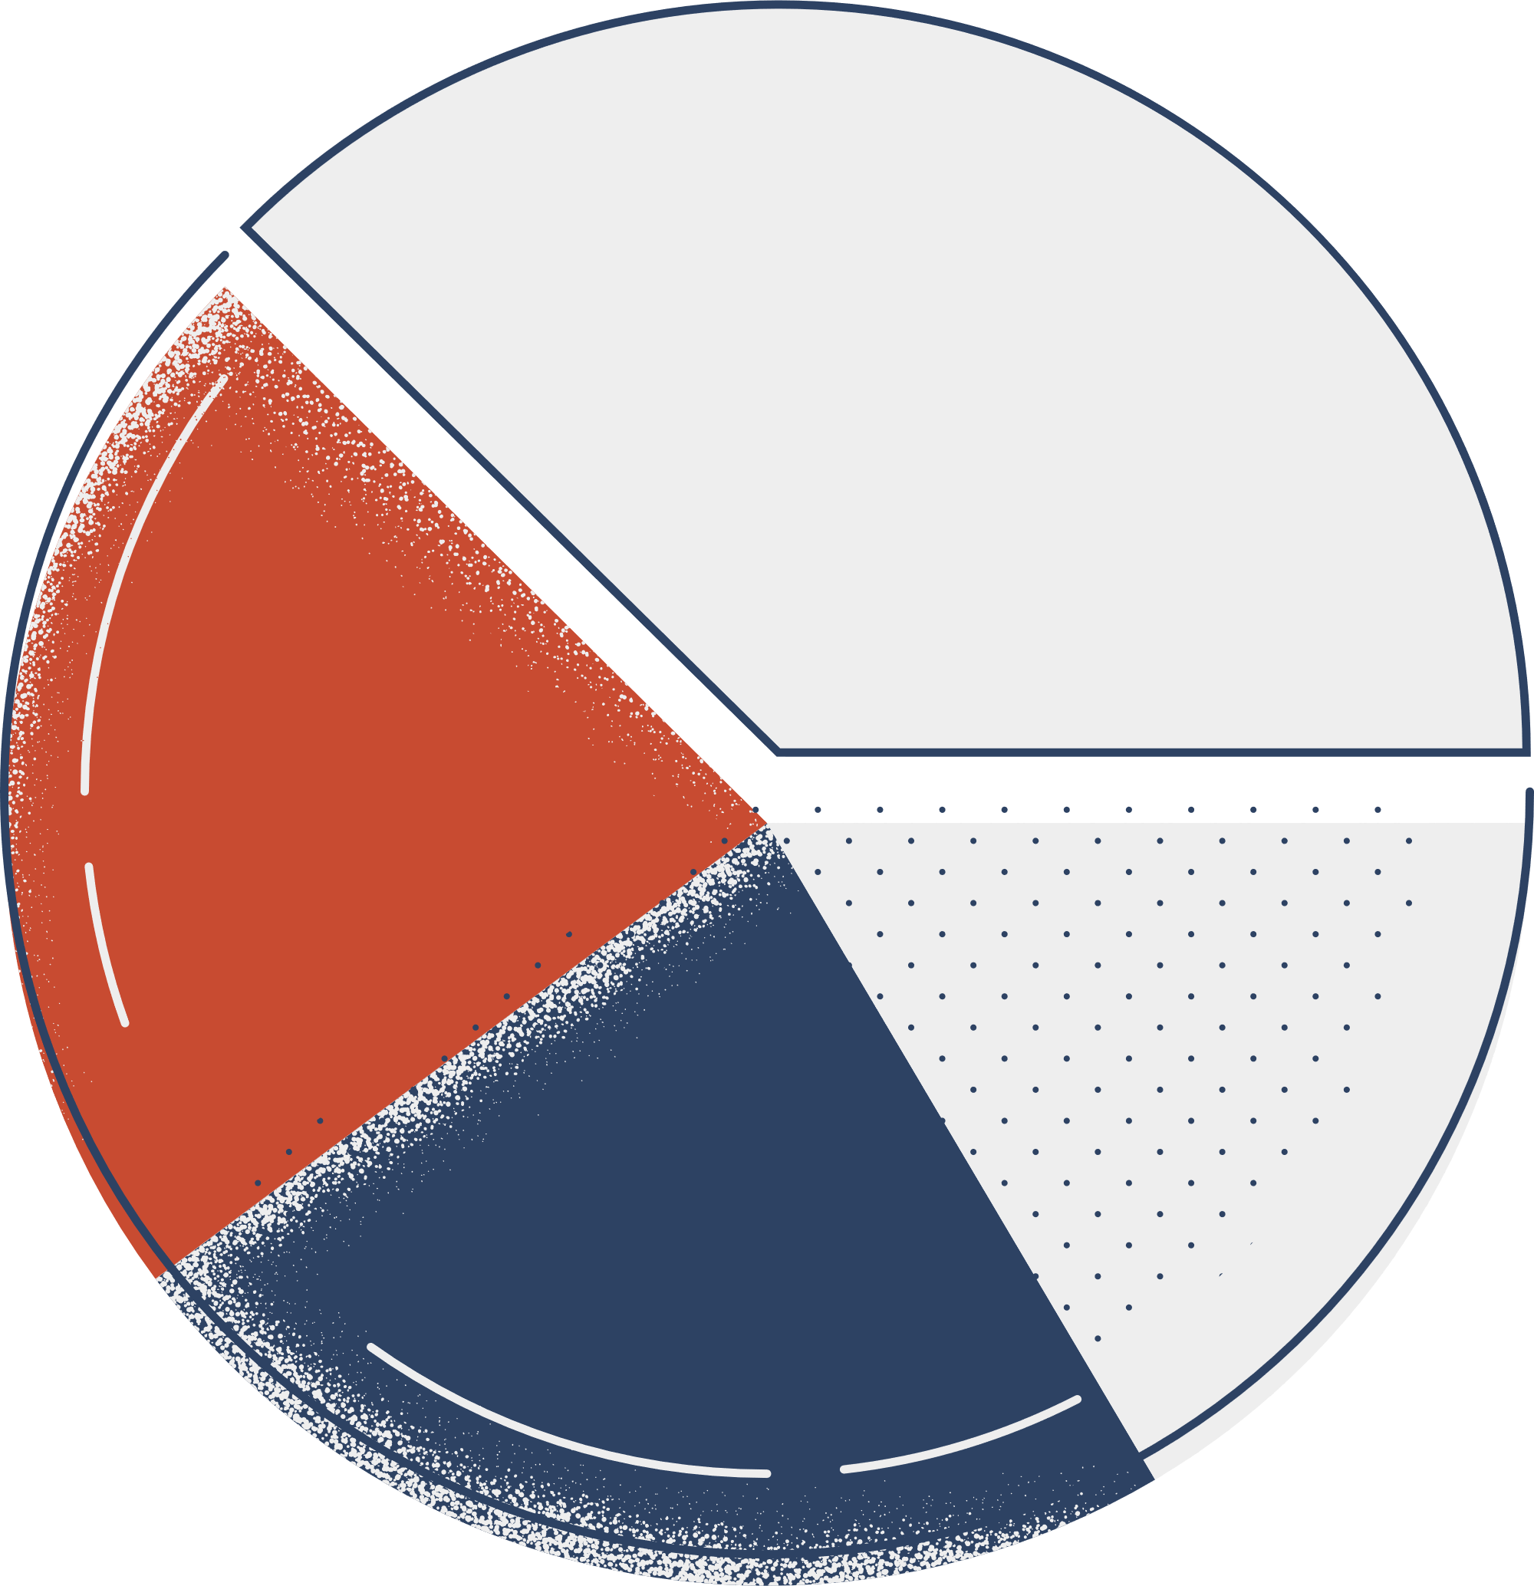
VIII
Literature Review
The "Smart" Translator
If you’re in the healthcare industry, the need for language translation is even higher because of the involvement of human beings. Any minor error can be a threat to their lives. Therefore, hiring a professional and experienced translator is exceptionally crucial for effective communication between the doctor, nurses, and patients.

Slide 14
IX
Module Description
Tkinter
Tkinter is the standard GUI library for Python. Python when combined with Tkinter provides a fast and easy way to create GUI applications. Tkinter provides a powerful object- oriented interface to the Tk GUI toolkit. Creating a GUI application using Tkinter is an easy task. All you need to do is perform the following steps:-
Import the Tkinter module.
Create the GUI application main window.
Add one or more of the above-mentioned widgets to the GUI application.
Enter the main event loop to take action against each event triggered by the user.

Slide 15
IX
Module Description
UUID
Universal Unique Identifier, is a python library which helps in generating random objects of 128 bits as ids. It provides the uniqueness as it generates ids on the basis of time. In this project, UUID is used for localization of the project.
SDK
SDK stands for software development kit or devkit for short. It’s a set of software tools and programs used by developers to create applications for specific platforms. In this program, we are using azure.cognitiveservices.speech module as SDK.

Slide 16
IX
Module Description
Speech SDK
The Speech SDK (software development kit) exposes many of the Speech service capabilities, so you can develop speech-enabled applications. The Speech SDK is available in many programming languages and across platforms. The Speech SDK is ideal for both real-time and non-real-time scenarios, by using local devices, files, Azure Blob Storage, and input and output streams.

Slide 17
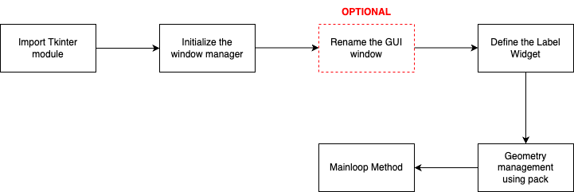
X
Module Work Flow explanation

Slide 18
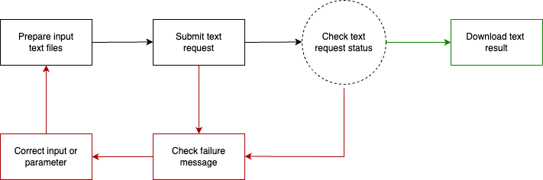
X
Module Work Flow explanation

Slide 19

X
Module Work Flow explanation

Slide 20

XI
Implementation and Coding

Slide 21
XII
Demo Video

Slide 22
XIII
Snapshot
Language Data File
Secret Key
Location
Azure Account and Subscription

Slide 23
XIV
Testing

Slide 24
XV
Result

Slide 25
XVI
Conclusion

Slide 26

The End
Thank you
for listening!

